Slide 1
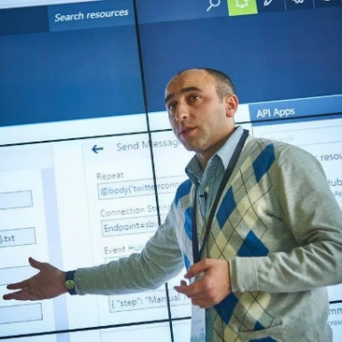
Logic App: Best Practices, Tips & Tricks
Sandro Pereira

Slide 2



Sandro Pereira
Head of Integration @DevScope
Microsoft Azure MVP
sandro.pereira@devscope.net
linkedin.com/in/sandropereira
@sandro_asp
https://blog.sandro-pereira.com/
Public speaker
Father
Book author: “BizTalk Mapping Patterns and Best Practices”
+351 223 751 350
www.devscope.net
Notes:
Interested in all things integration – which of course includes MS Flow

Slide 3

this house have kids'…

Slide 4

I quickly implement them, and they seem to be working fine, but… How are my Logic Apps? What Was Wrong?
LISA SANDERS, M.D.

Slide 5

1
Use descriptive names
Improves readability
Transfer knowledge
You can’t rename Logic Apps… directly
LA naming convention….

Slide 6
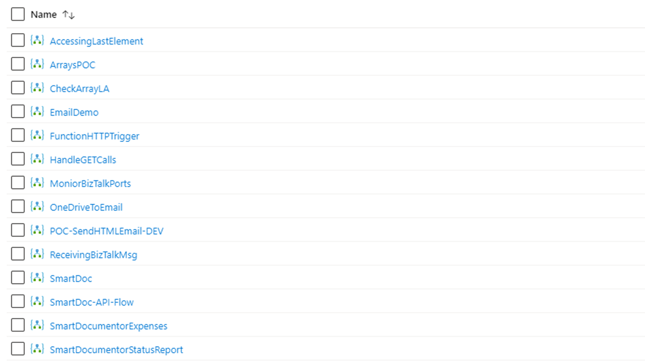

POC-AccessingLastElementXMLArray-DEV
POC-WorkingWithArrays-DEV
POC-CheckJSONStructureContainArray-DEV
GAB2020-Event-EmailDemo
POC-CallAzureFunctionHTTPTrigger-DEV
POC-HowToHandleGetCalls-DEV
<project-name>-MonitorBizTalkPorts-PRD
IntMonday-Event-OneDriveToEmailDemo
POC-ReceiveJSONDemoMsgFromBizTalk-DEV
POC-OCR-SmartDocumentor-DEV
DVS-SmartDocumentor-InvoiceProcessing-PRD
DVS-SmartDocumentor-ExpensesProcessing-PRD
DVS-SmartDocumentor-SubmissionStatusReport-PRD

Slide 7
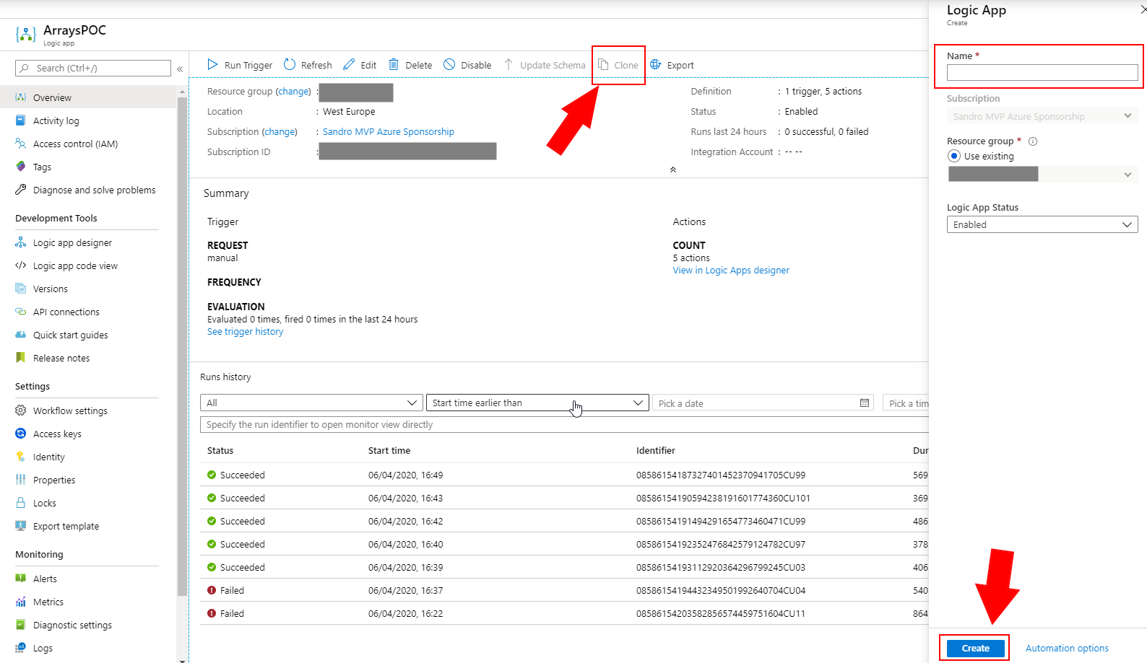

Slide 8
2
Use descriptive names
Improves readability
Transfer knowledge
You can’t rename actions that have dependencies…
name and rename actions….

Slide 9
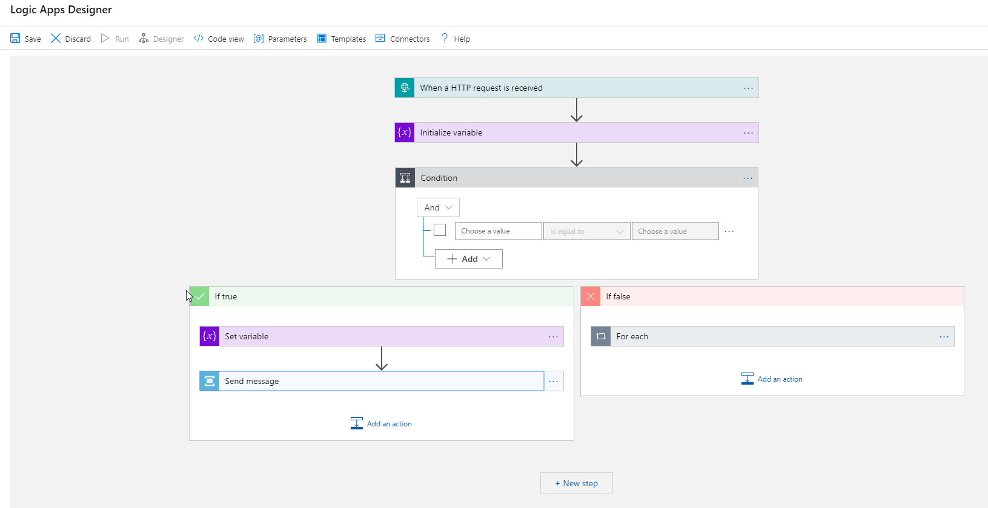
Use descriptive names
Improves readability
Transfer knowledge
You can’t rename actions that have dependencies… directly

Slide 10
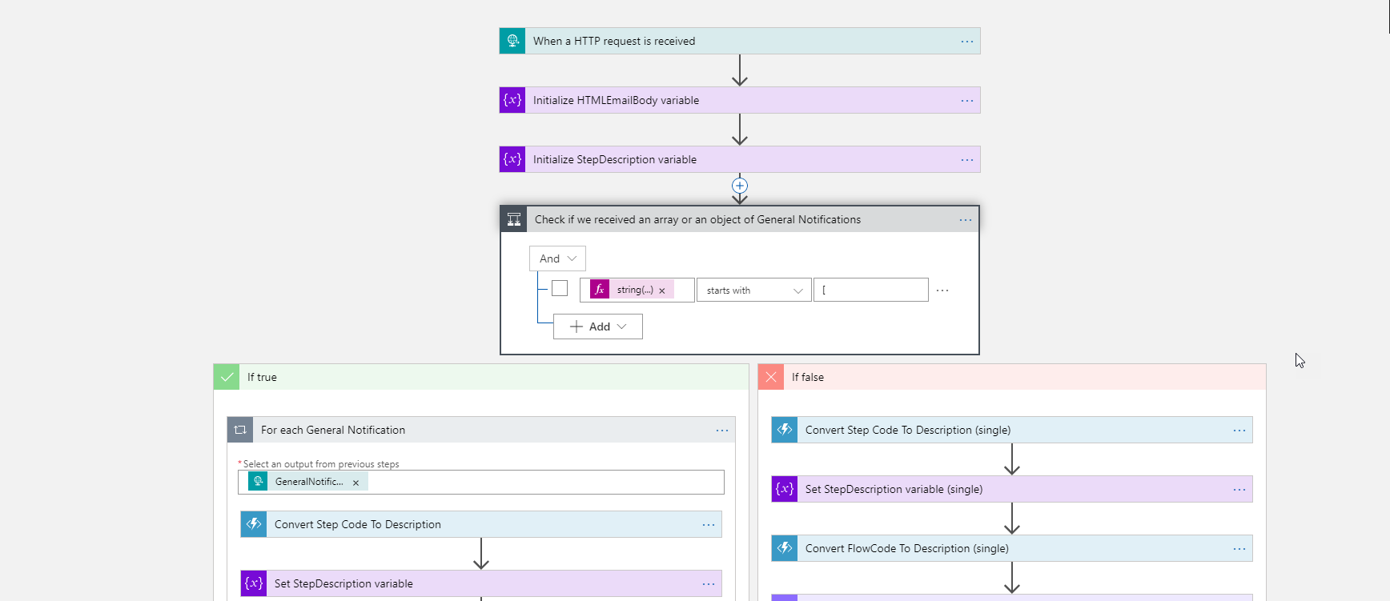

Slide 11

3
how to rename actions with dependencies? It is possible?
You can’t rename actions that
have dependencies…
directly

Slide 12
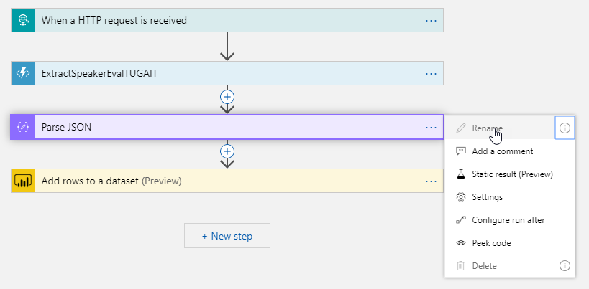
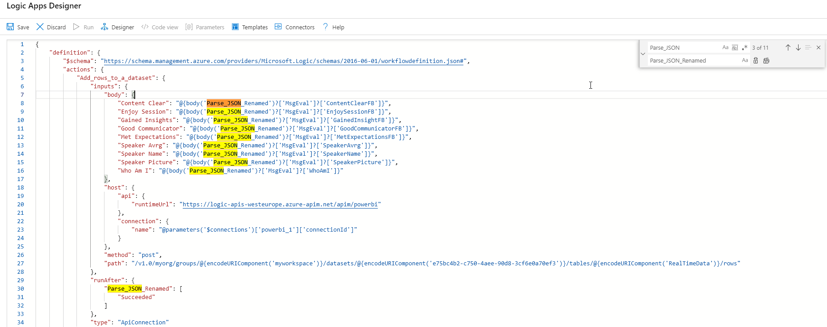
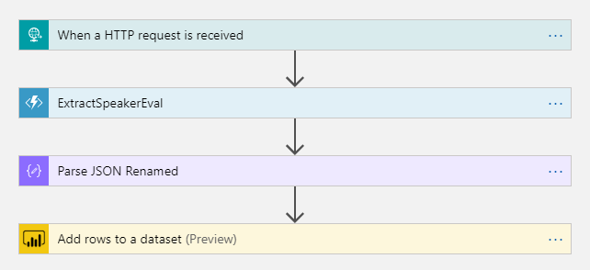

Slide 13

4
add comments….
Everyone can read the comments
Save yourself and teammats from future frustration
Every expression should have a comment

Slide 14
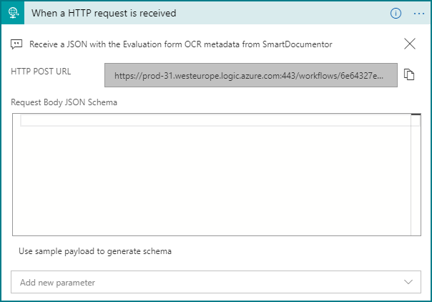
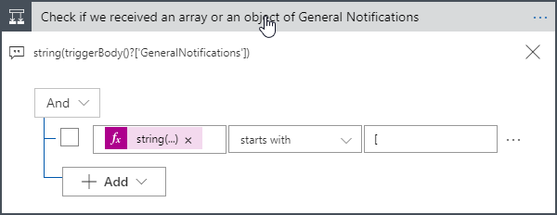
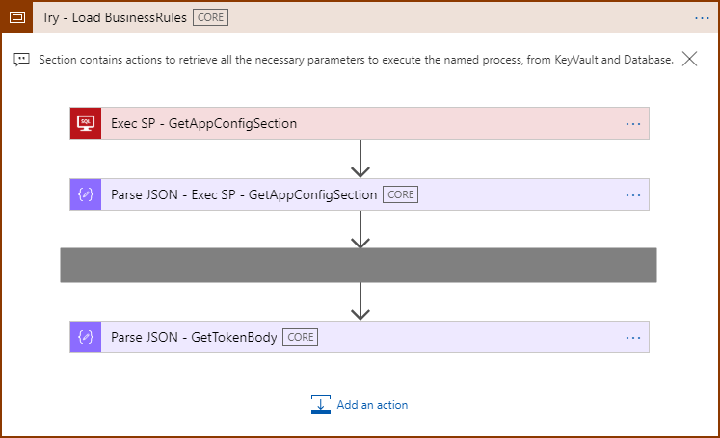
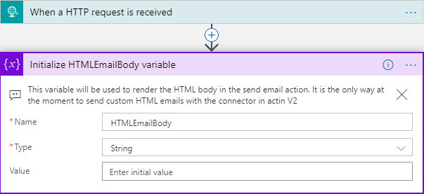

Slide 15

5
Managing individual actions introduces complexity
Scopes group actions together (regions)
Manage actions as a single unit instead of disparate items
using scopes…

Slide 16
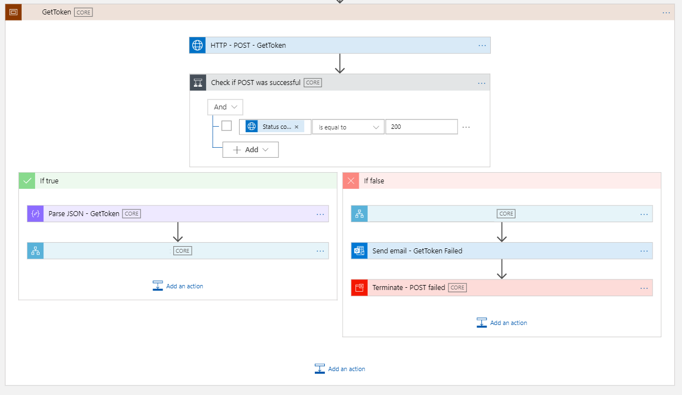

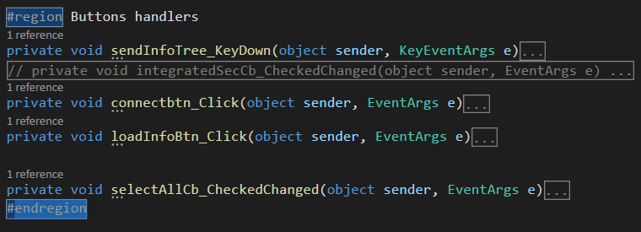
scope… is a region

Slide 17
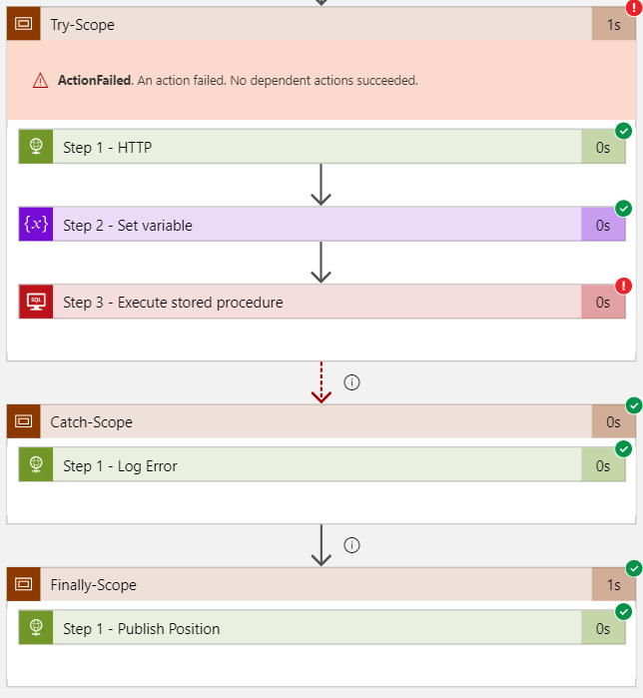
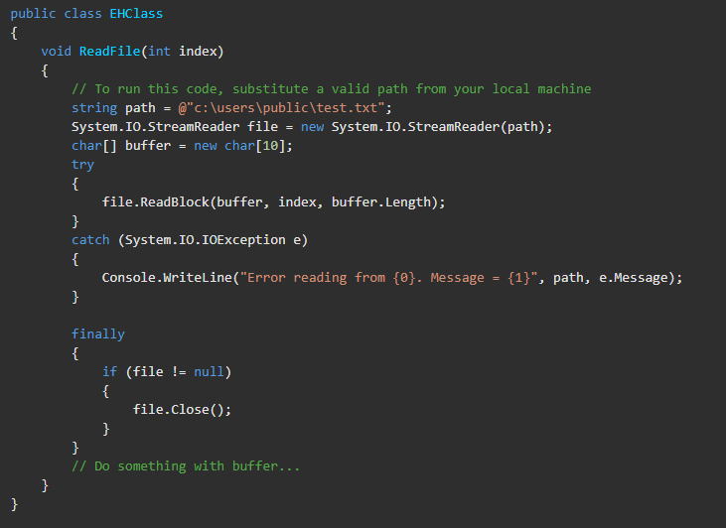
scope… is a try-catch-finally

Slide 18

6
error handling…
configure run after settings

Slide 19
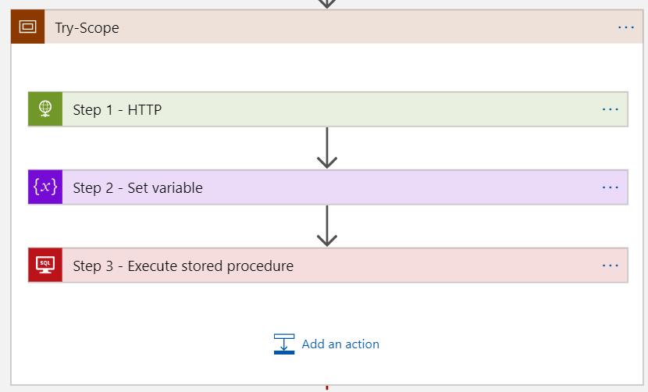
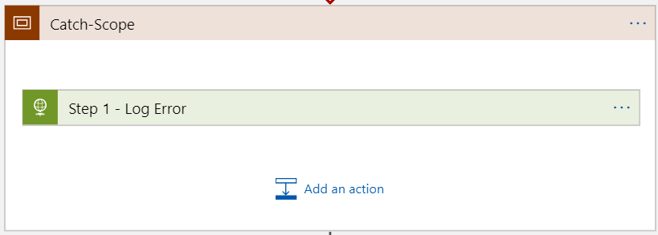
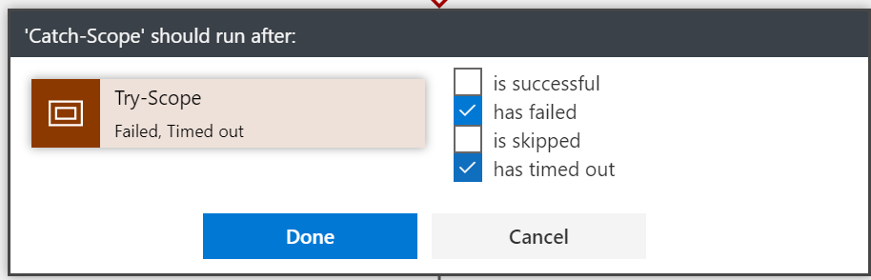
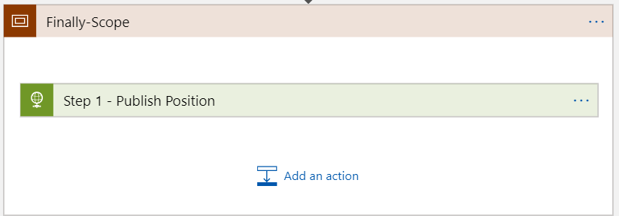
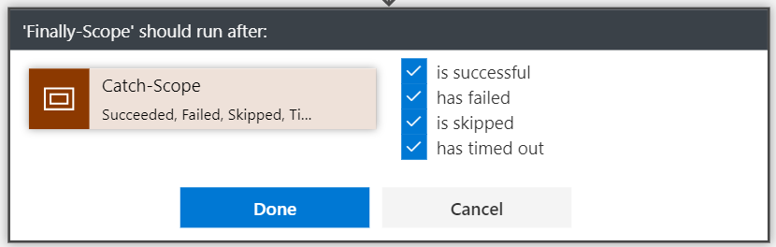

Slide 20
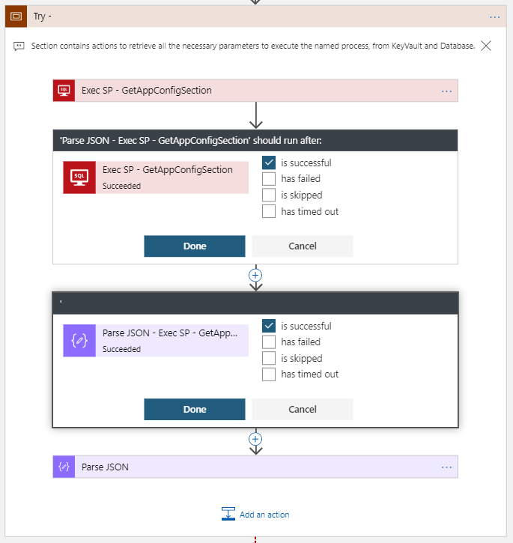
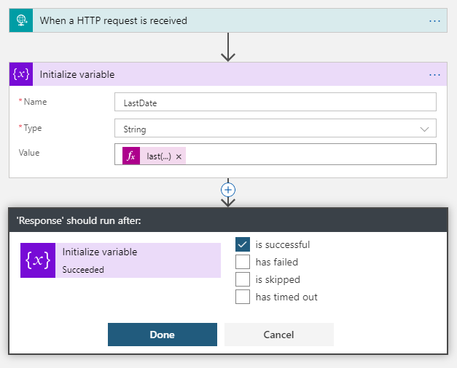

Slide 21

7
learn from failures …

Slide 22
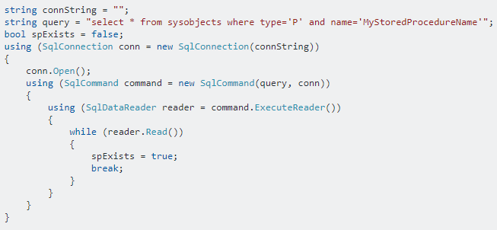
C# developer’s implement defensive code…

Slide 23
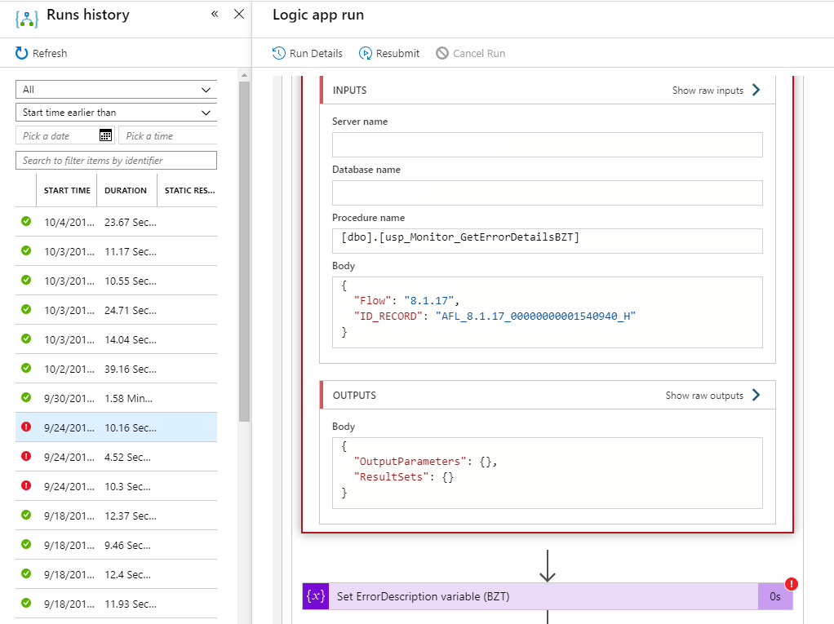
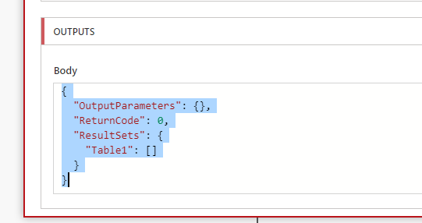
… with not in Logic Apps?

Slide 24
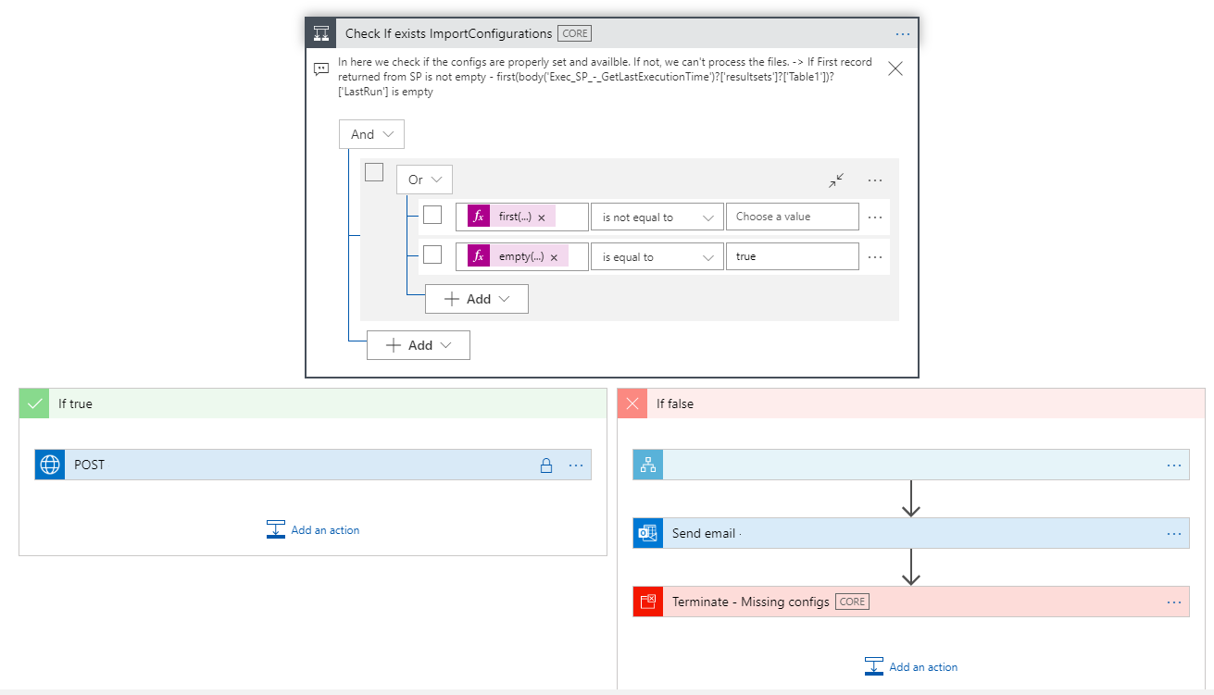
first(body('Exec_SP_-_GetLastExecutionTime')?['resultsets']?['Table1'])?['LastRun']
empty(body('Exec_SP_-_GetLastExecutionTime')?['resultsets']?['Table1'])

Slide 25

8
expressions nightmare….

Slide 26
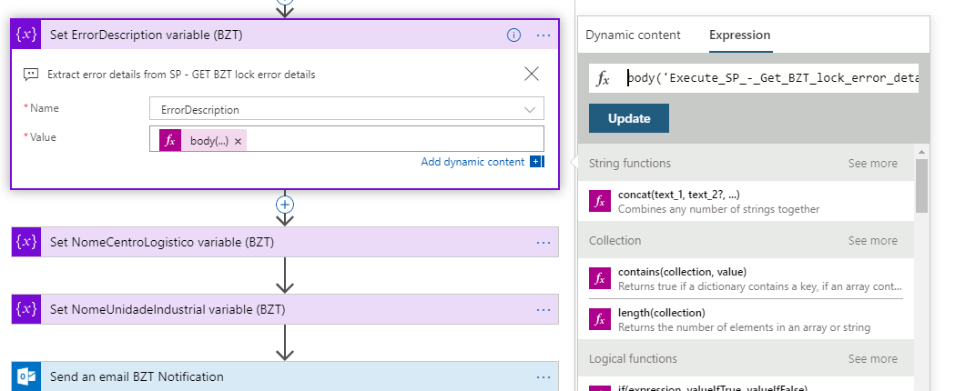
body('Execute_SP_-_Get_BZT_lock_error_details')?['ResultSets']?['Table1'][0]?['ErrorDescription’]
concat(div(sub(ticks(utcNow()), ticks(item()?['Created'])), 10000000), ' segundo(s)')
int(div(add(add(int(variables('ContentClear')), int(variables('GoodCommunicator'))) , add(int(variables('EnjoySession')), int(variables('MetExpectation')))),4))

Slide 27
body('Execute_SP_-_Get_BZT_lock_error_details')
Name of the actions with the space replace by underscore

Slide 28
int(
div(
add(
add(
int(variables('ContentClear')),
int(variables('GoodCommunicator’))
) ,
add(
int(variables('EnjoySession')),
int(variables('MetExpectation’))
)
)
,4
)
)

Slide 29

9
control your connectors (API connections)
Duplicate connections
Unused connections
Who are using this connections?

Slide 30
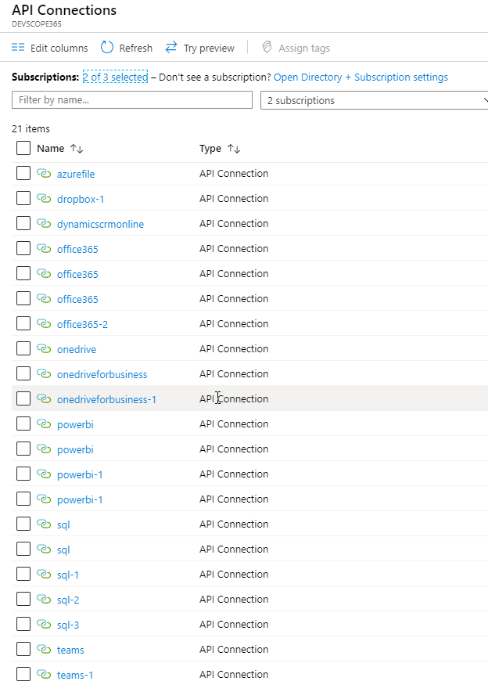
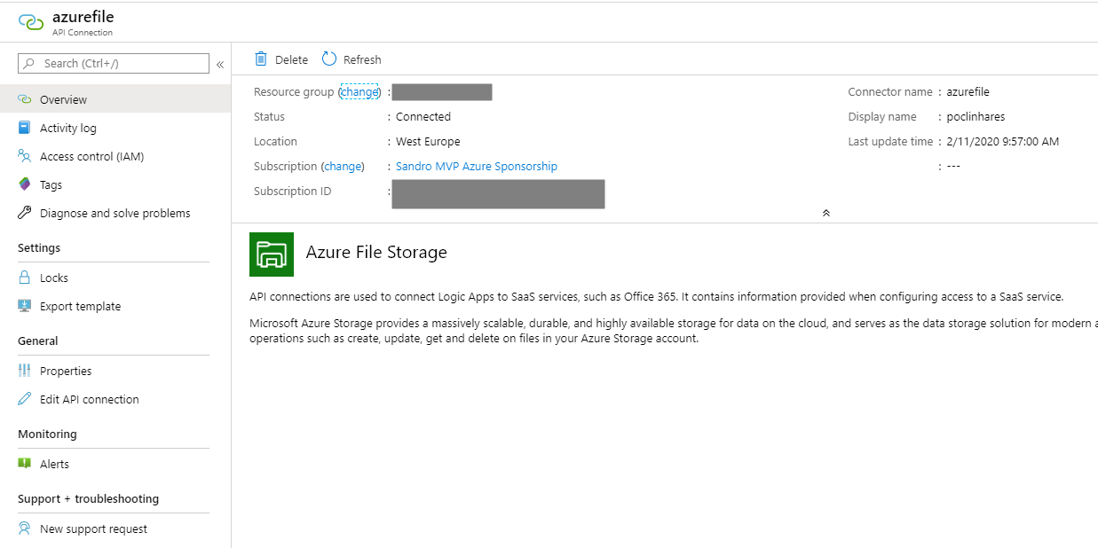
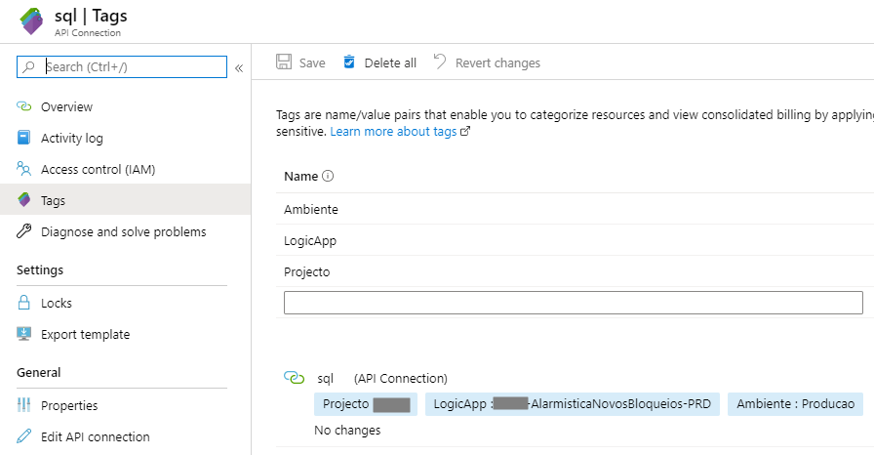

Slide 31

10
There is no simple and direct way to find unused API Connections
Nightmare for governance
One of the biggest pains in Logic App development
find orphaned API Connectors…

Slide 32
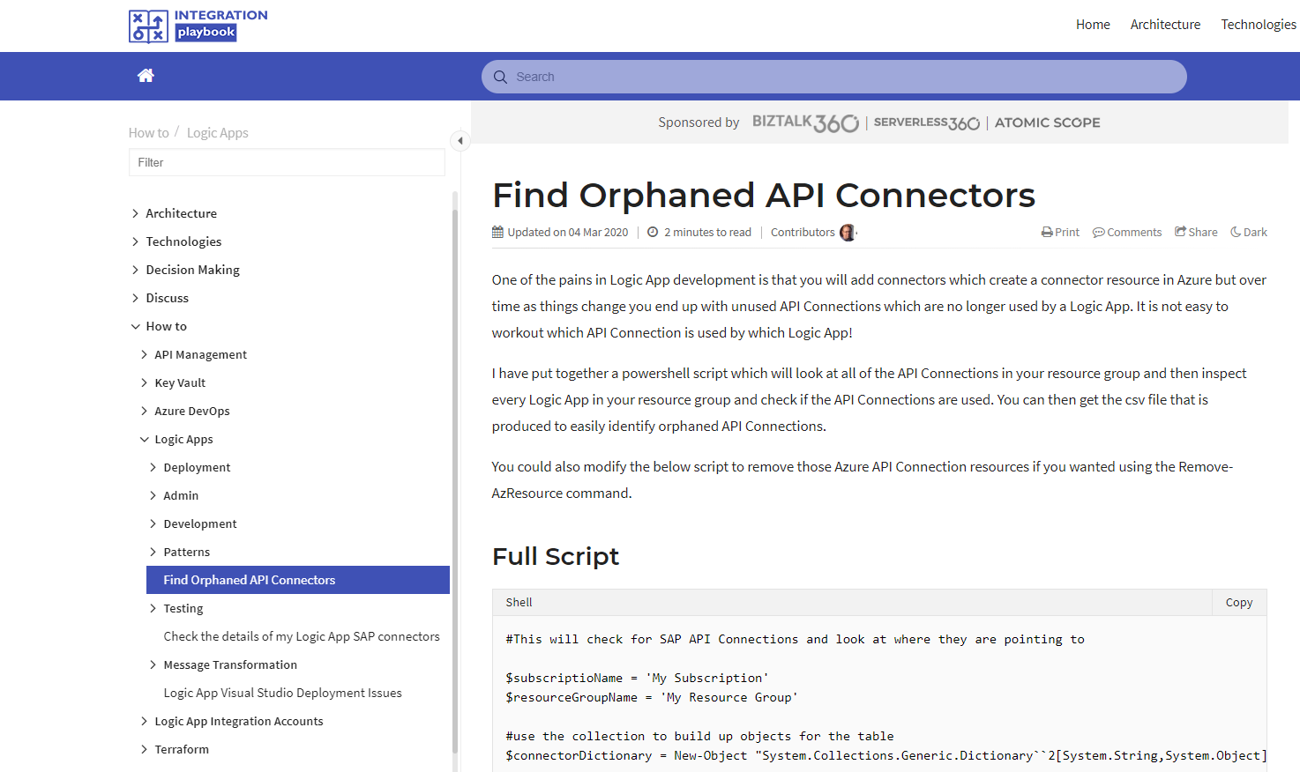

https://www.integration-playbook.io/docs/find-orphaned-api-connectors

Slide 33
11
fix connectors (API connections) …
Logic Apps Designer performs design-time checks against your logic app flow for design issues
Errors put into focus to save your time and frustration

Slide 34
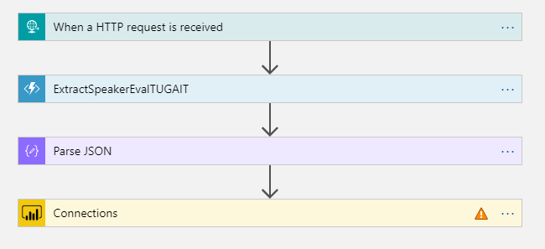
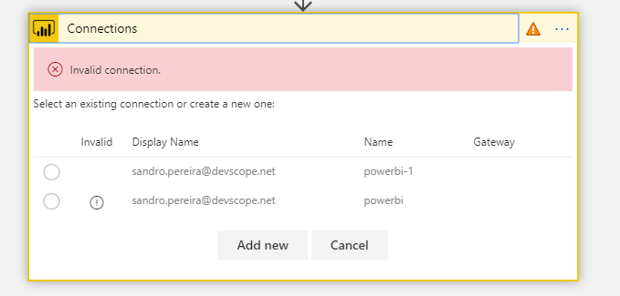

Slide 35
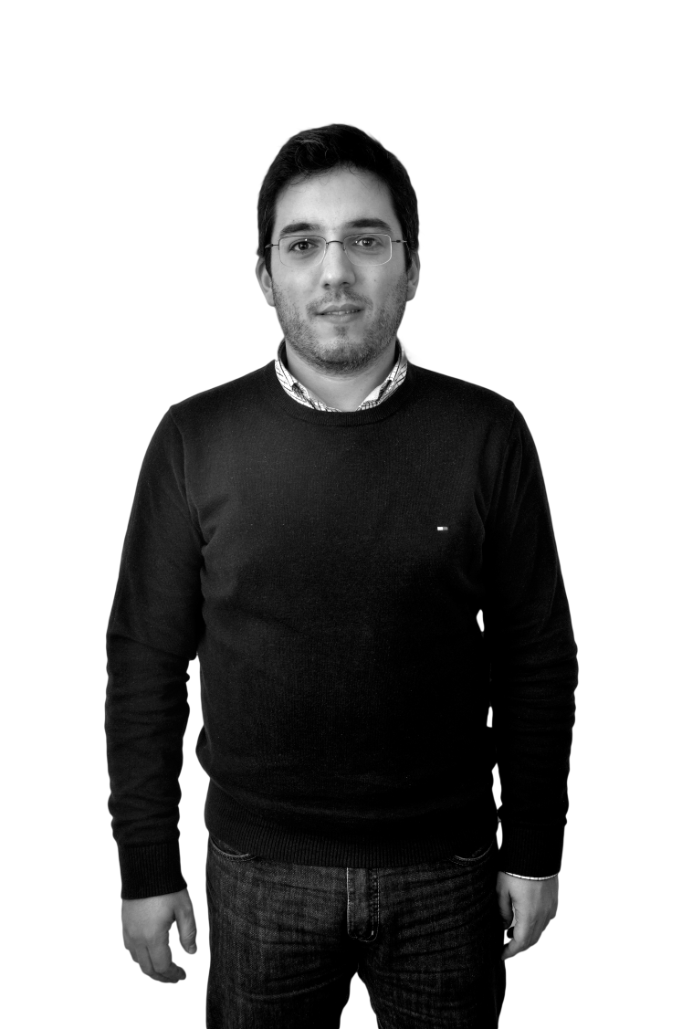


Thanks!
DevScope
+351 223 751 350
support@devscope.net
https://pt.linkedin.com/company/devscope
@DevScope
www.devscope.net
Visual Studio &
Development Technologies
Data Platform
Microsoft Azure
Sandro Pereira
sandro.pereira@devscope.net
linkedin.com/in/sandropereira
@sandro_asp
https://blog.sandro-pereira.com/
Microsoft MVP Award recognizes exceptional community leadership

